Slide 1
Virtually There
Working with Virtual systems

Slide 2
What is a Virtual Computer

Slide 3
What is a Virtual Computer – Definitions
Abstraction – The process of reducing, automating, or eliminating a concept or procedure in order to make it simpler.
Cloud – Providing some sort of hardware or services through one or more layers of abstraction.
Host – A system that generates virtual hardware that another operating system can run.
Guest – An operating system that is installed on hardware that another host system generates for it.
SAN – any type of storage (including Directly attached, NAS, etc).
Bare-metal – An installation installed on physical hardware instead of virtual.

Slide 4
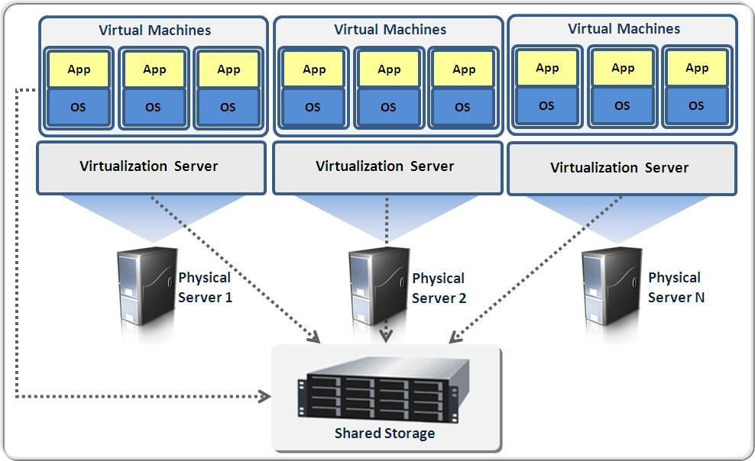
What is a Virtual Computer - Concept
Hypervisor

Slide 5
What is a Virtual Computer - Types
Container (Full virtualizing) – All components of the guest system are virtual (VMWare, Microsoft Hyper-v, KVM).
Partial Virtualization (Para-virtualization) – Some but not all components of the guest system are virtualized (Proxmox, OpenVZ, RedHat ).

Slide 6
What is a Virtual Computer - Types
A Type 1 hypervisor is also called a bare-metal hypervisor, these are installed straight on top of the hardware.
These have the added benefit of being very efficient with resources.
However, these can be more complicated to manage then a Type 2 hypervisor.
A Type 2 hypervisor is installed inside of another system just like another program would be.
Because a Type 2 hypervisor is installed in an operating system and because the program doesn’t have control over the hardware resources it uses more resources to run.

Slide 7
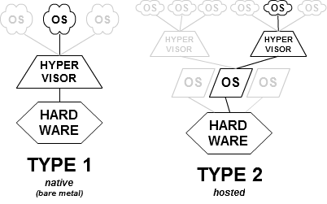
What is a Virtual Computer - Types

Slide 8
How to Manage a Virtual Guest

Slide 9
How to Manage a Virtual Guest - Install
Installing
For the most part once you get a system up any management that is going to take place will happen inside the guest itself.
VMware tools – Allows transparency into VMs

Slide 10
How to Manage a Virtual Host

Slide 11

Thank You
Patrick J Williamson
AHS Product Engineer I
Modular Mining Systems, Inc.
Cell: +1 (520) 912-6321
Office: +1 (520) 806-3340
Williamson@mmsi.com

